Slide 1
Tournament Management Software
UA Badminton Club
Status Update 2
Junfeng Xu, Enfa George, Rupal Jain, Urvika Gola

Slide 2

Structure of the Presentation
Plan & Accomplishment
Current Status
System Description
Challenges
Project Management
Demo

Slide 3

Plan & Accomplishment
Notes:
1 min

Slide 4
Plan and Accomplishment
Plan for this iteration
Backend support for the user login/signup functions
Database setup and database table creation
Player dashboard functionalities
Front end UI web pages
Backend support
Store and retrieve player profile
Store and retrieve player event registration
Testing for completed functionalities
Customer showcase
Team accomplishment
Notes:
1.5

Slide 5
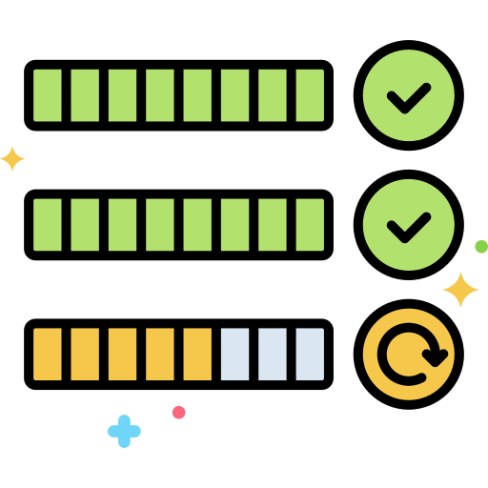
Current Status

Slide 6
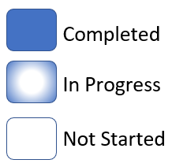
Current Status with Block Diagrams
To show our progress since last iteration
Module by module
Color code
Notes:
Our software has four main modules.
Seed & Draw: The system generates tournament schedules based on the number of players and teams, and it assigns players to matches based on their proficiency levels. The system also allows tournament organizers to manually adjust the schedule if necessary. The system can be configured to schedule matches at specific times and dates.
Match Management: The system gives the admin the ability to update matches live. It tracks the progress of each match and displays the results on a live scoreboard. Players and spectators can access the scoreboard from their mobile devices or computers to see the current score, game and set counts, and other relevant information.

Slide 7
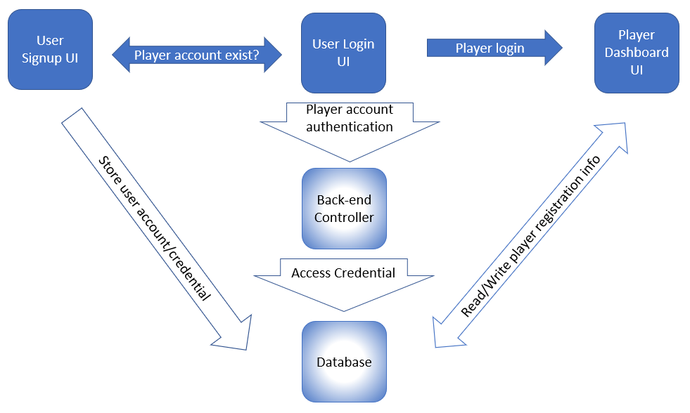
Registration module (Status 1 condition)

Slide 8
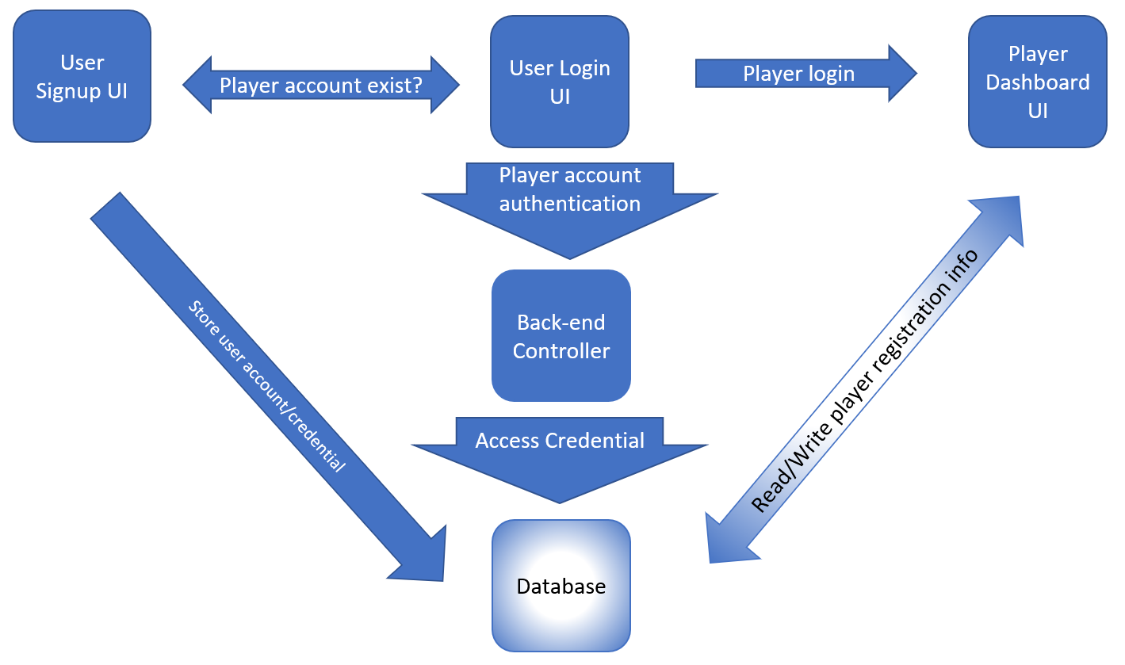
Registration module (Status 2 condition)

Slide 9
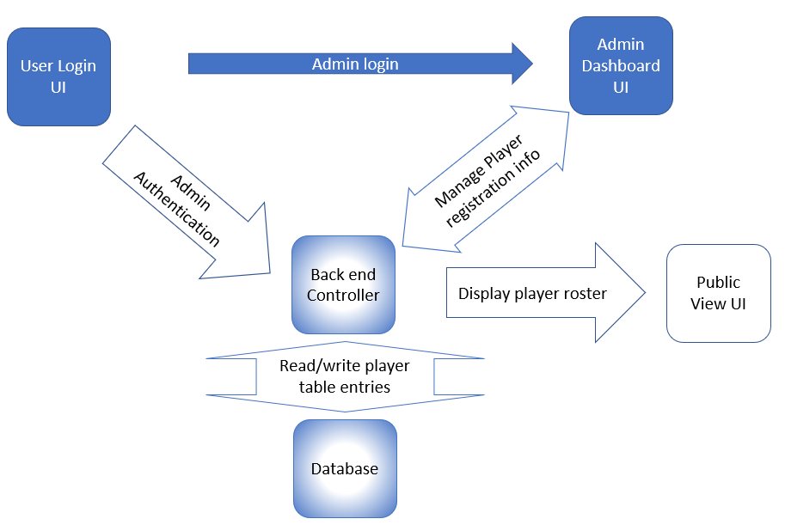
User Management module (Status 1 condition)

Slide 10
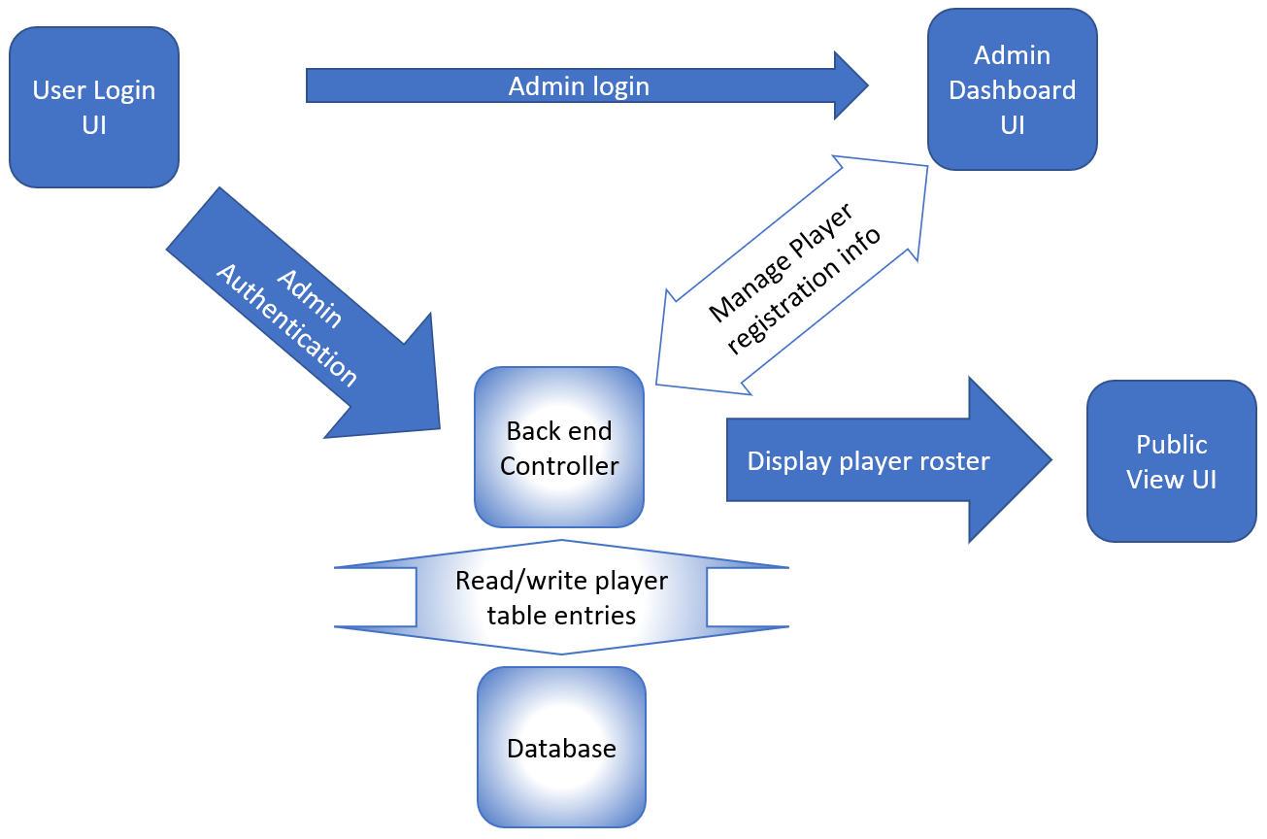
User Management module (Status 2 condition)

Slide 11
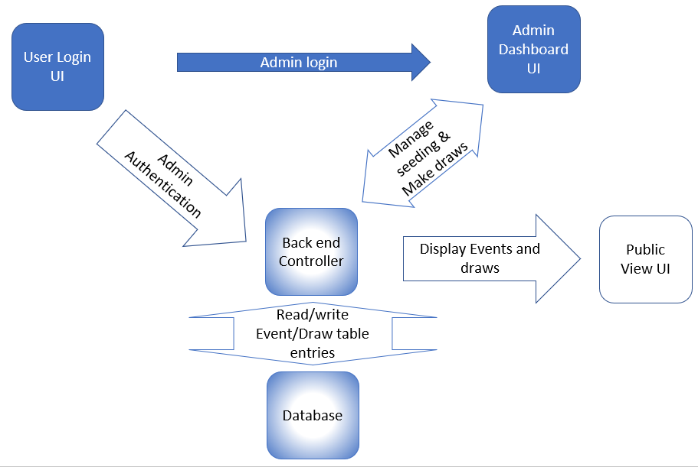
Seed & Draw module (Status 1 condition)

Slide 12
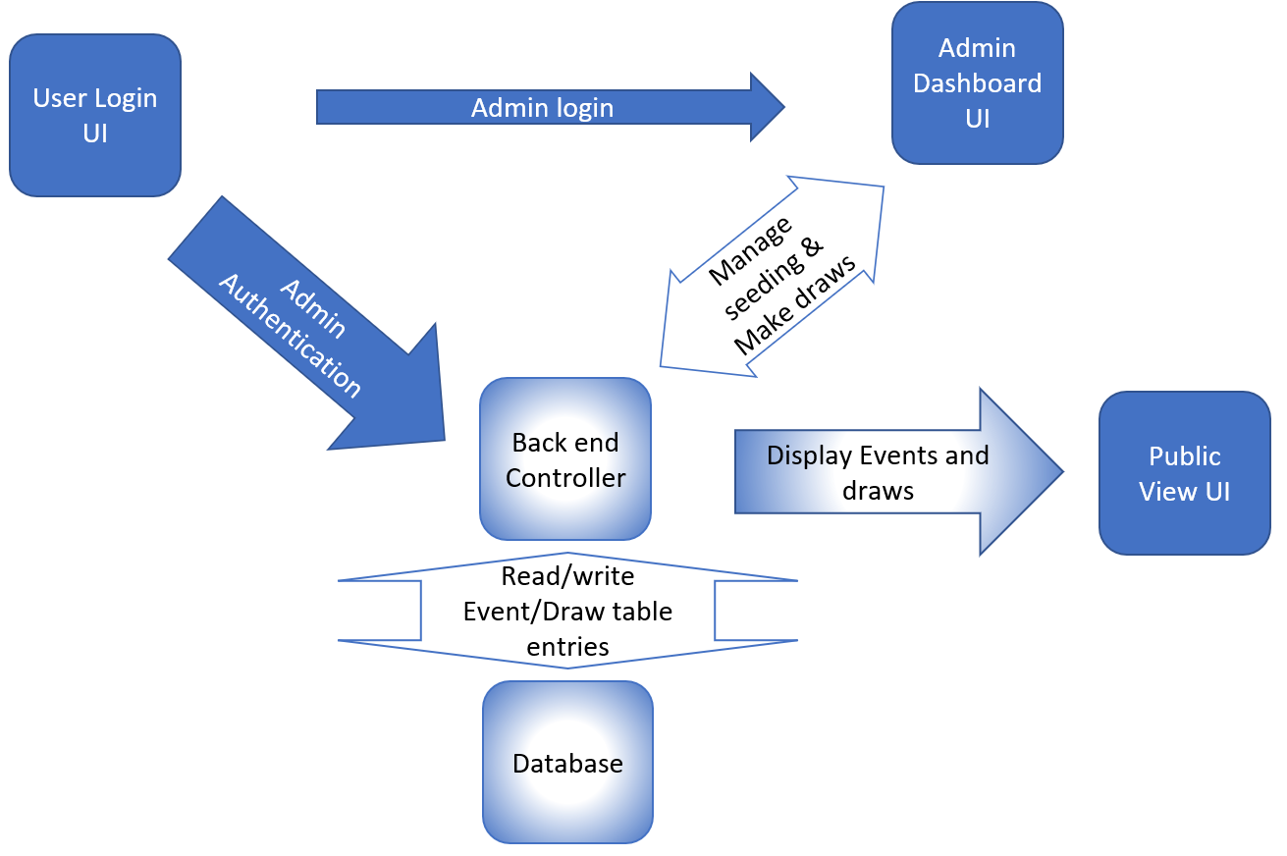
Seed & Draw module (Status 2 condition)

Slide 13
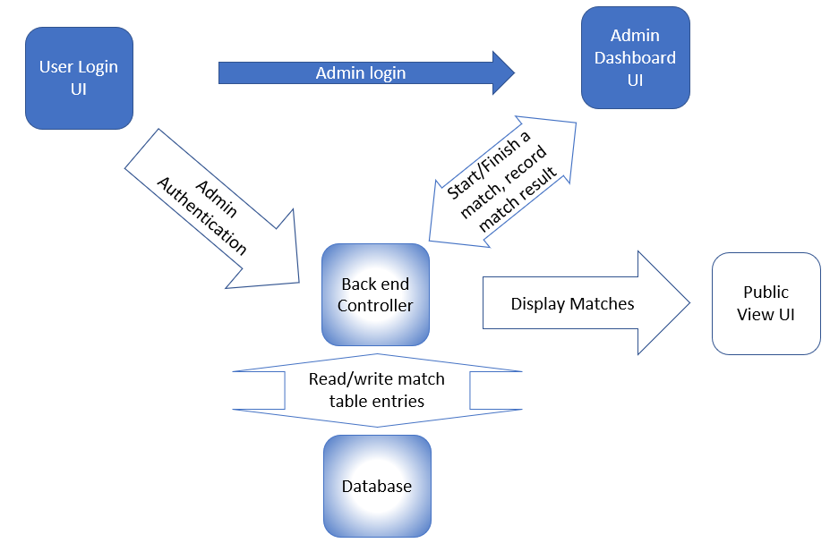
Match Management module (Status 1 condition)

Slide 14
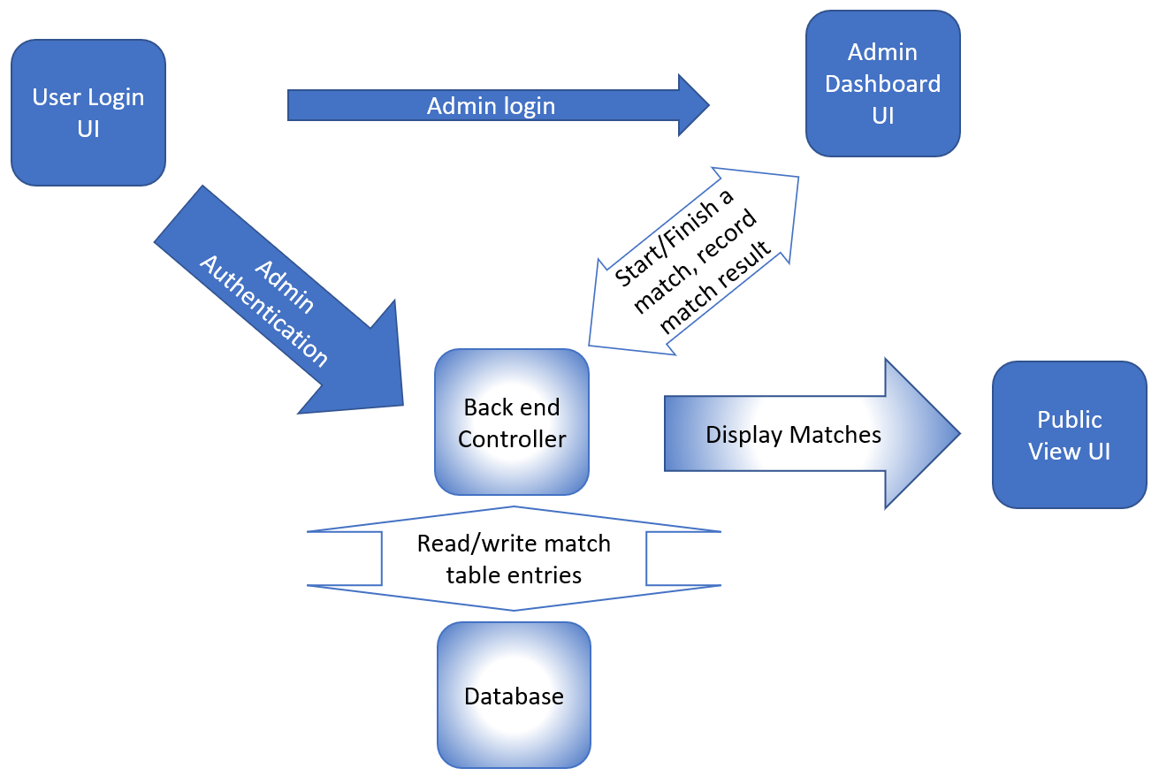
Match Management module (Status 2 condition)

Slide 15

System Description

Slide 16
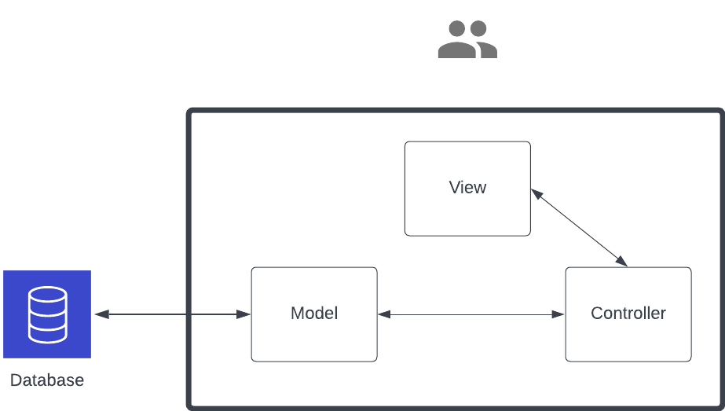
System Overview
User
Notes:
The design uses a model-view-controller architecture. Model module handles the logic of the system and the database. The Model will interact with the database layer to store and retrieve data.
The View consists of the user interface and presentation of the system. It is responsible for displaying data to the user and receiving input from the user. The interface in the view module has been isolated from the implementation logic as the view may be updated over time.
The Controller acts as an intermediary between the Model and the View. It receives input from the View and pass it to the Model for processing, and similarly pass it back to the View for presentation.
The boundaries of the system are clearly defined, with the Model representing the business logic, the View representing the presentation, and the Controller acting as an intermediary between the Model and the View.

Slide 17
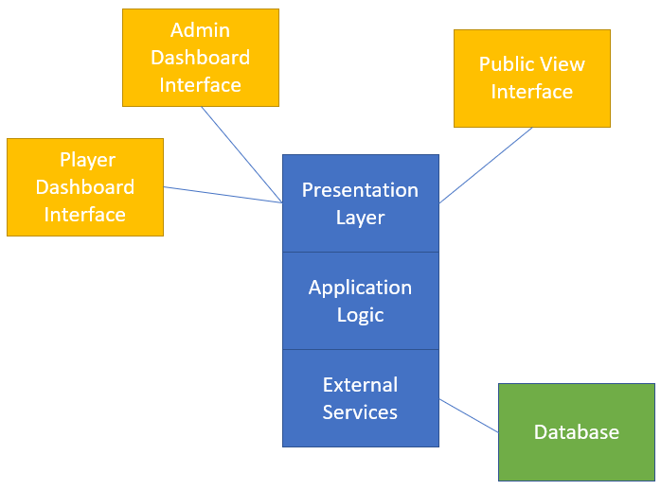
System Architecture Views - Logical View
Notes:
We have two views for our system. The first one is the logical view.
This diagram focuses on the end-user functionality. It includes Presentation layer which shows the 3 interfaces of our application, basically each interface is for a type of user: admin, player and public.
Application layer contains the logic to connect interfaces with the external services.
Our external sources include the databases which has been developed using amazon RDS that runs postgres SQL.
By constructing such a view, we were able to get answers to the questions asked by the customer and helped in accommodating the changes in the requirements.

Slide 18
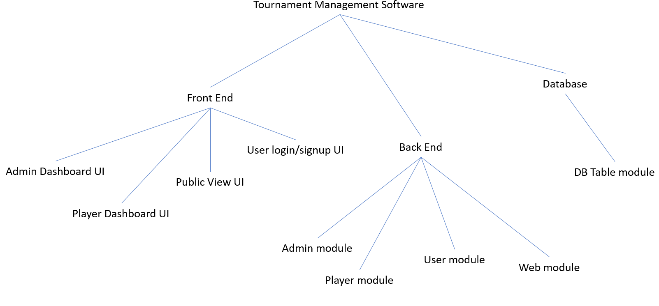
System Architecture Views - Development View
Notes:
Here is the second view for our system. Development views focuses on the modular decomposition of the source code. It has been divided into 3 elements.
Front-end module which is our View handles the presentation and consists of 4 submodules developed by 2 members of the team.
Similarly, Backend module which is the Model, consists of 4 submodules which has been maintained by 2 members of the team and the last module is the database setup with one submodule handled by one of the members.
This view helped in maintaining the parts of the system that are relevant to the customers need and will also help the future developers to understand the basic structure of the system. We used this view to estimate the time and development efforts and assign tasks to everybody.

Slide 19



Challenges
Notes:
Lets talk about challenges and how we were able to overcome the roadblocks we encountered on our way.

Slide 20
Overcoming Database Hurdles
Challenge - Difficulty starting Oracle on Amazon EC2 instance due to configuration issues after installation.
Attempted Solution: Reinstalling Oracle DB on Amazon EC2, but issue persisted.
Impact: Delayed timeline by 3 days, resulting in increased development time.
Solution: Leveraged alternative database system - Postgres. Installed and familiarized with Postgres on Mac locally,
Next Steps: Installed Postgres on Amazon RDS and successfully connected it with EC2, resolving the Oracle configuration challenges.
Results: Connected the product database setup using SQLAlchemy to our Flask Application, and the project timeline was back on track.
Notes:
One of the backlog items in our sprint, and it continued to be a challenge in this sprint as well. We faced challenges starting Oracle on Amazon EC2 due to configuration issues, We tried reinstalling Oracle, but the issue persisted. This delayed the project timeline by 3 days already. So, we leveraged Postgres as an alternative database system, installed and familiarized with it locally. Then, we installed Postgres on Amazon RDS and successfully connected it with EC2, which resolved the Oracle configuration challenges. As a result, we connected the product database setup using SQLAlchemy to our Flask Application, and the project timeline was back on track.

Slide 21
A retrospective…
Key takeaways: Flexibility and adaptability are crucial in overcoming unforeseen challenges.
How? By being open to alternative solutions and willing to adapt to changing circumstances, we were able to overcome obstacles and ultimately achieve our goals.
Notes:
From a technical perspective, this experience highlights the importance of being open to alternative solutions when faced with unexpected challenges. As a team's ability we identify and leverage a suitable alternative database system, and successfully connect it to our application. And we will take this learning to our next and final sprint.

Slide 22
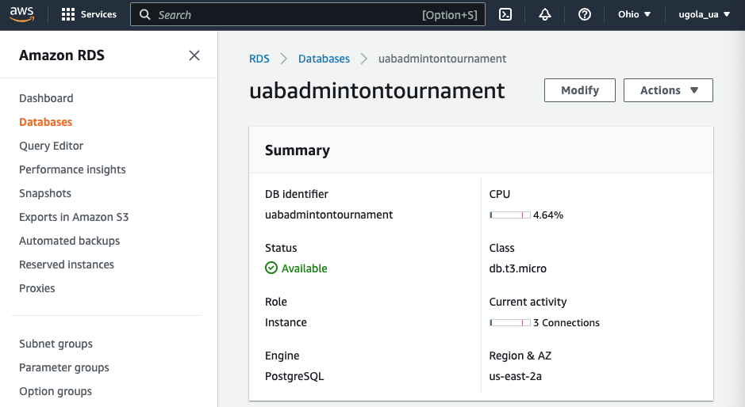
Benefits of Using Amazon RDS for our Software
Notes:
It gives many benefits but the ones that are relevant to our projects irs Why we are doing this:
Principle of Separation of Duty. Amazon RDS allows for separation of database administration tasks.
Cost effective, on student account we get 20gb storage free.
Scalability and Performance: Amazon RDS provides easy scalability options to handle the varying workload demands of a tournament management software. It allows for automatic scaling of compute and storage resources, ensuring optimal performance during peak usage periods.

Slide 23

Project Management
Notes:
Let’s now get into the project management principles

Slide 24
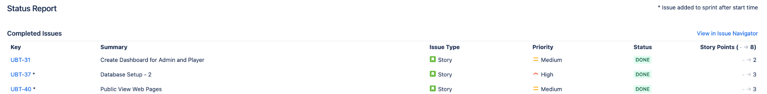
Jira Sprint
Sprint Duration - 10/Apr/23 to 25/Apr/23
3 Stories
40 Subtasks
Notes:
To medium to high prior

Slide 25
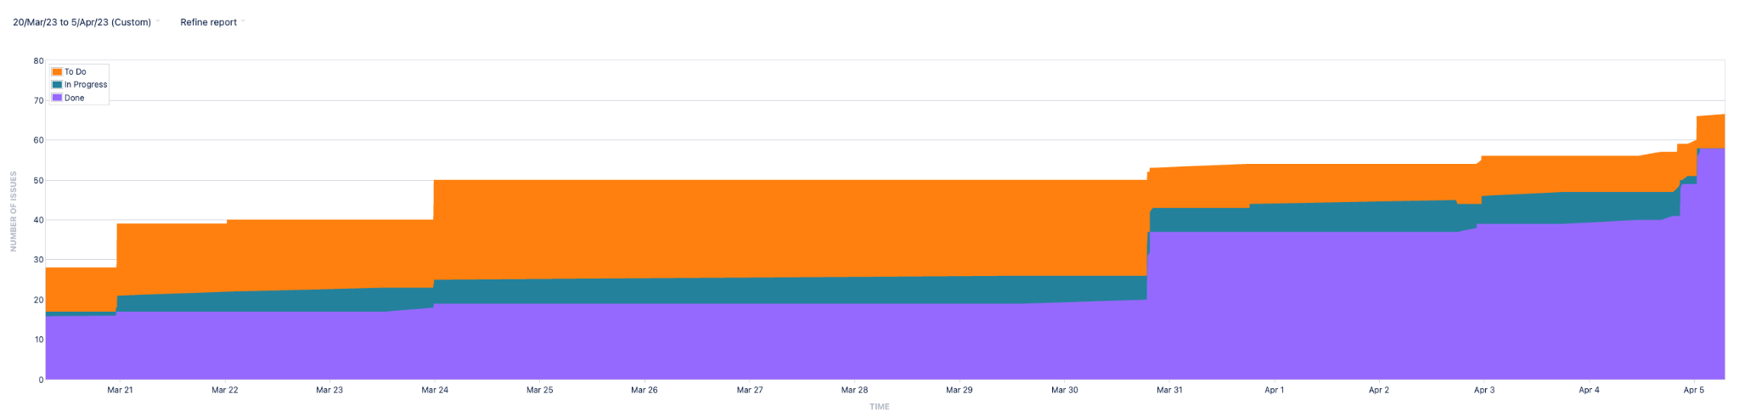
Cumulative Flow Diagram
Notes:
providing insight into the team's progress and performance.

Slide 26
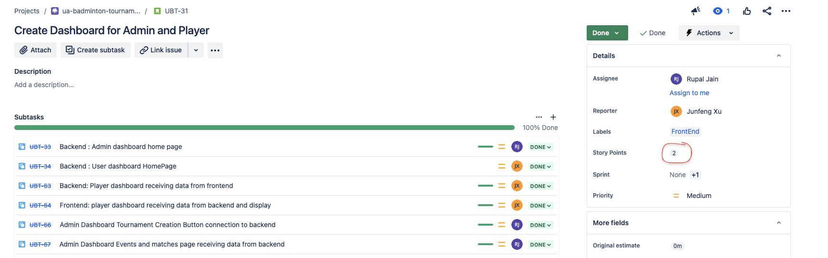
Incorporated 1, 2, 3 Story Points
Notes:
2 I know how to do it but it would take some work

Slide 27
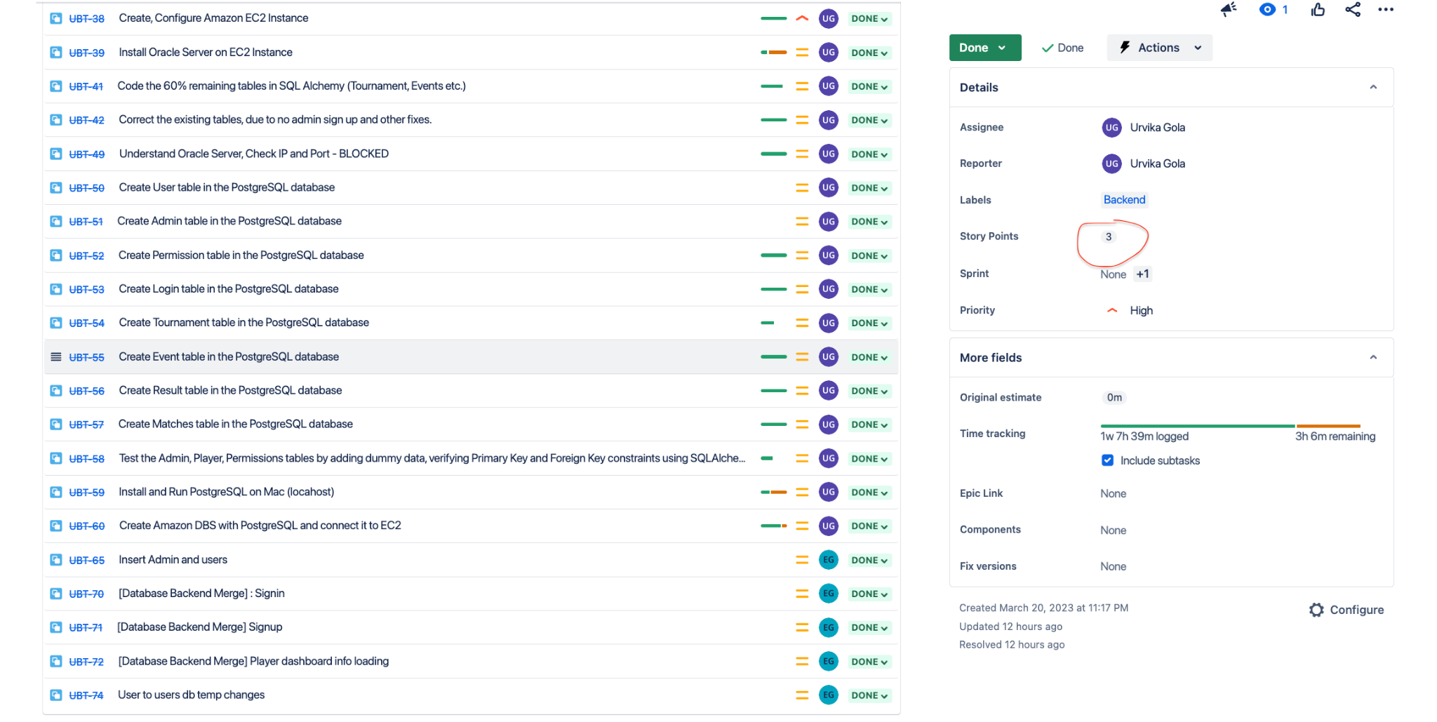
Incorporated Story Points
Notes:
I would need to figure it out how to do it.

Slide 28
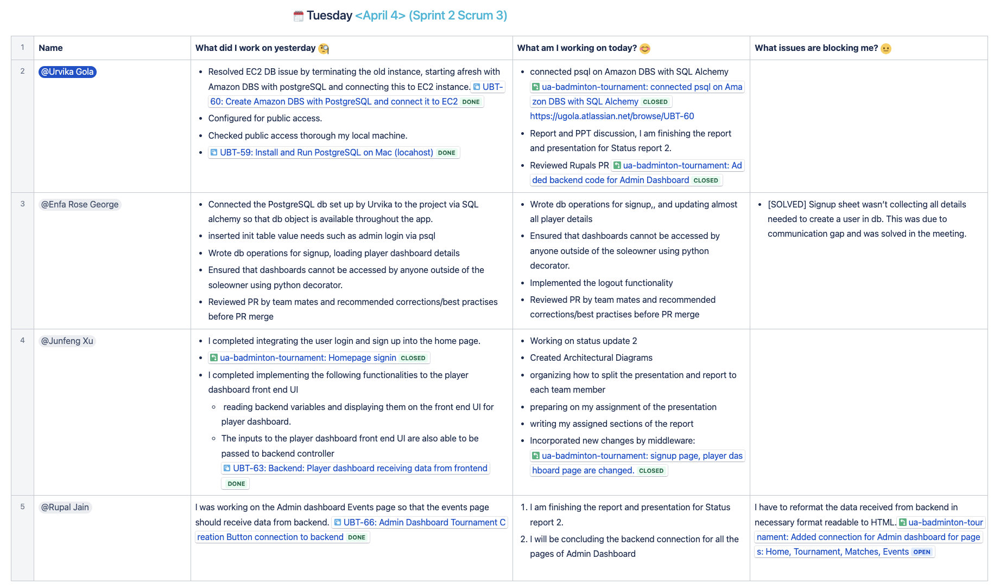
Daily Dashboard

Slide 29


Slide 30

Notes:
We are now open for questions and answers.

